Slide 1
산업 경쟁력 제고 혁신전략
2020 SW산업 전망 컨퍼런스

Slide 2









산업의 와해적 변화

Slide 3
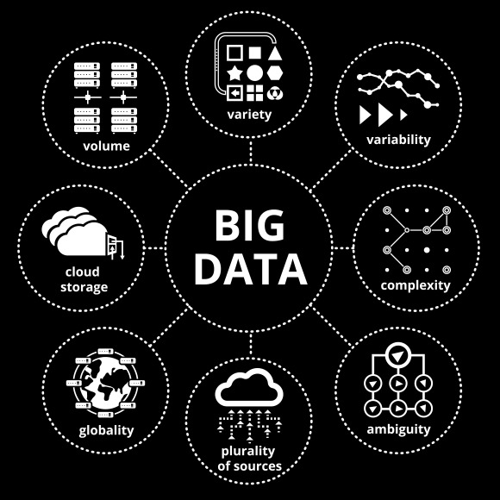
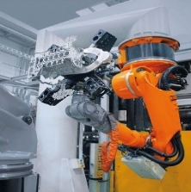




기술 융복합의 산업혁신
Media
Content Streaming, eBooks
Travel & Transport
Content Streaming, eBooks
Big Data
3D Printing, Robotics, IOT
Banking
Branchless Banking
Utilities
Smart Grids
Retail
Virtual Stores and more e-Commerce
Analytics & AI
AR VR
Healthcare
EMR and Point of Care Solutions
Government
Smart Cities Digital Citizen services
Cloud Computing
Cyber Security

Slide 4
IT 투자목적 변화
Navigating an Era of Digital Transformation: Top Drivers for IT Investment, Global, 2016 to 2018
2016
2018
Change 2016 to 2018
Base: All respondents (n=1980); Multiple Responses
Q7a: What are the top three drivers for IT investment in the next year?
Q7b: What are the top three drivers for IT investments in the next 3 years?

Slide 5
디지털 전환의 접근방향
“Getting there”
“How to get there”
Implementation
Strategic Intent
“Where do we want to be”
Strategy Development
Develop the implementation plan
Manage the digital PMO
Provide a monitoring and review mechanism
“Get the basics right”
Strategic Intent
Development
Develop the digital strategy
Create the digital roadmap
Define the people, process and technology framework
Design the organizational Structure
Develop the reengineering plan
“Where are we”
Digital Strategy Drivers
Business impact of digital
Digital vision development
Develop digital impact measurement metrics
Diagnostics
Market digital drivers
Competitive digital plays
Digital opportunity assessment
Costs of not going digital
Quick Wins
Activities
As-Is Digital Maturity Assessment
Future state visioning
Gap Identification

Slide 6
디저털 전환의 4대 관점
Application Centric Approach
Business User Involvement
Connected & Integrated Strategy
Defense & Security Consideration

Slide 7

A: Application Centric Approach
Operations
Markets
Shift in the global balance of economic powers
Process Efficiency Focus
Cost Optimization Pivotal
Continual Innovation
Demographic Shifts
New Channels & Disinter- mediation
Employees
Customers
Employee Engagement Gaining Prominence
Employee Productivity a key metric
Proactive Engagement
Personalized Offering
Instant Gratification
Rise of GenY

Slide 8
B: Business User Involvement
TRADITIONAL
MODERN
EMERGING
KPIs for Digital Investments
Performance
and Budget
Delivery of Results
Enabling Business Outcomes
Role of Business Stakeholders
Adopt Implemented Technology
Drive Functional IT Initiatives
Lead a Digital First Approach
Role of IT Organization
Supports ‘Business As Usual’
Partner in Change
Create Strategic Advantage

Slide 9

C: Connected & Integrated Strategy
Collaborative
Empowered Employees
Social Business
Any Application
Real-time, data-driven decisions
24x7x365 Workday
Boundary-less
Any Device
Instant
messaging
Anywhere
Telephony
Agile
Anytime
Head-
Mounted Displays
Podcasting
Smart
Watch
On the go
Global
Telepresence
Home
Business Innovation
Work
Smartphone
Email
Tablet
Webcasting
Laptop/
desktop
Enterprise Social Network
Enterprise Applications
Document and Database Sharing

Slide 10
D: Defense & Security Consideration
Top Challenges for IT by Region
Navigating an Era of Digital Transformation: Top IT Challenges by Region, Global, 2016 to 2018
Europe
North
America
Asia
Pacific
Latin
America
Base: All respondents (n=1980); Multiple Responses
Q6: What are the tip 3 challenges your IT department faces in the next three years? ( Select 3)

Slide 11
금융산업의 주요 디지털 전환 기술
Cognitive Computing
Application
Technology
Context Aware Computing
Virtual Reality
Virtual Branch
Anything-as-a-Service
Augmented Reality
Biometric Mobile Wallet
Natural Language Processing
Augmented Banking
Context Aware Banking
Social Banking
Cognitive Banking Analytics
Technology
Personalized Virtual Banker
Cognitive Security
Short Term
(<2 years)
Medium Term
(2-4 years)
Long Term
(>4 years)
Innovation Opportunities

Slide 12
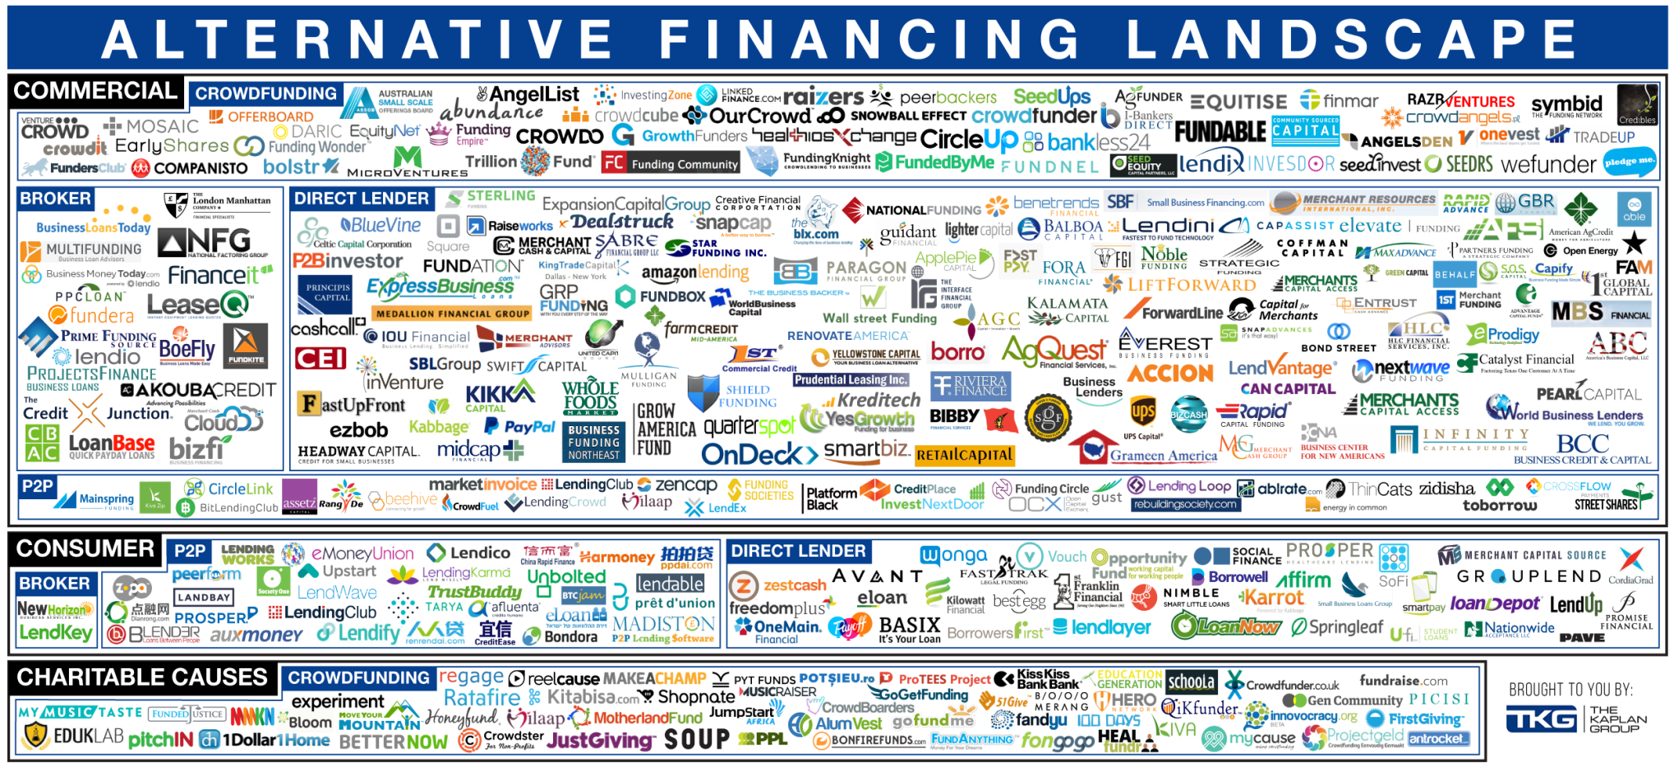

금융산업 디지털 전환 현황
“Banking is essential, Banks are not” – Bill Gates (1994)

Slide 13







금융산업의 와해적 비즈니스모델
#Keyword Search: 2017-18 Annual Reports

Slide 14
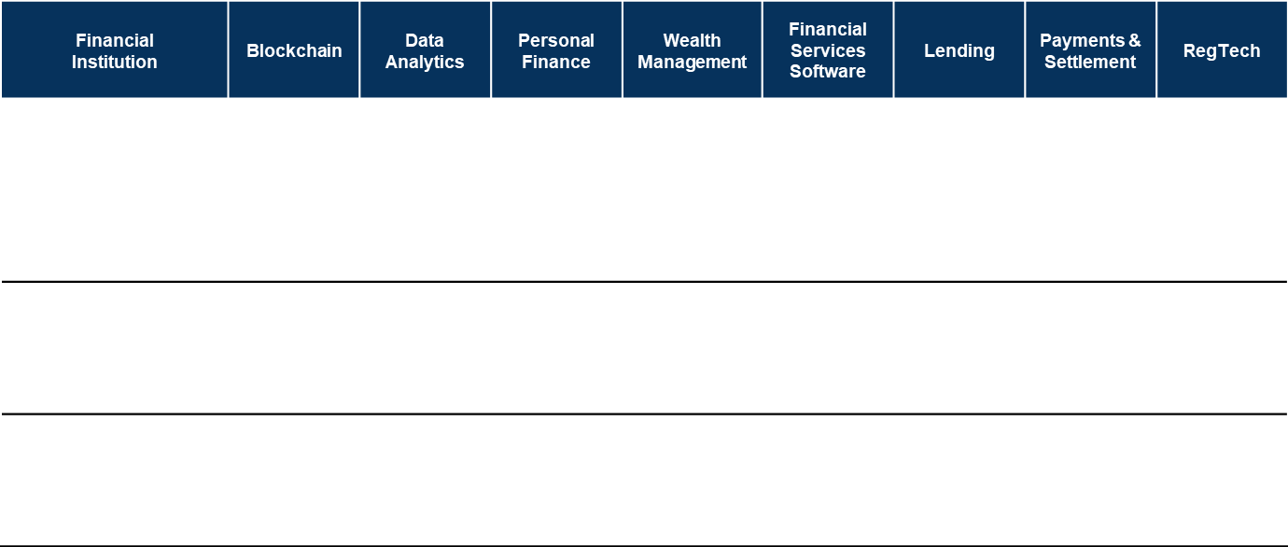























금융산업의 핀테크 투자

Slide 15
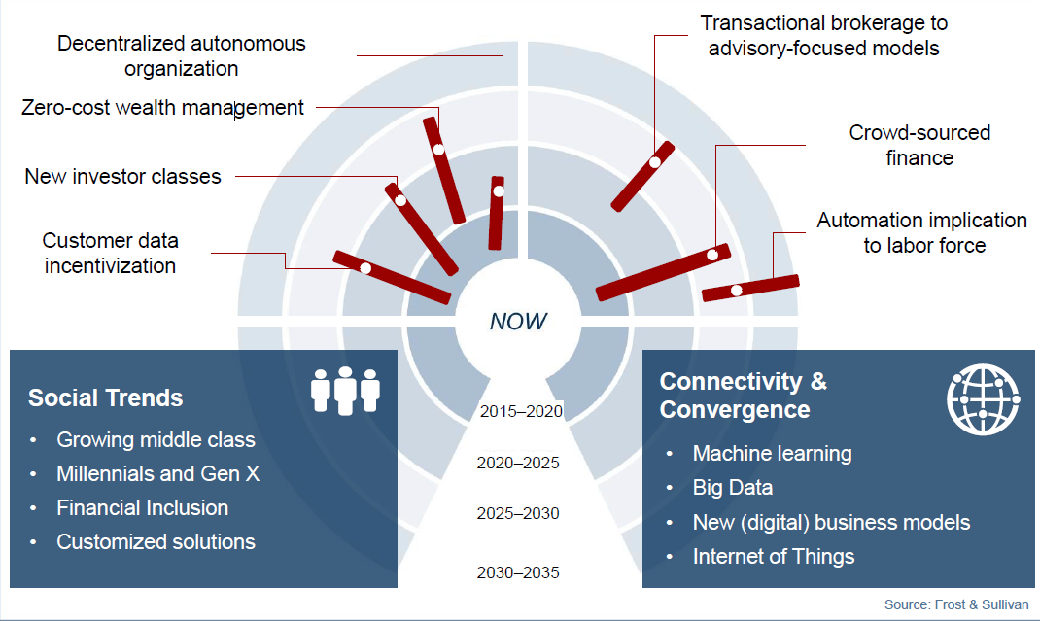
금융산업의 디지털 전환방향

Slide 16
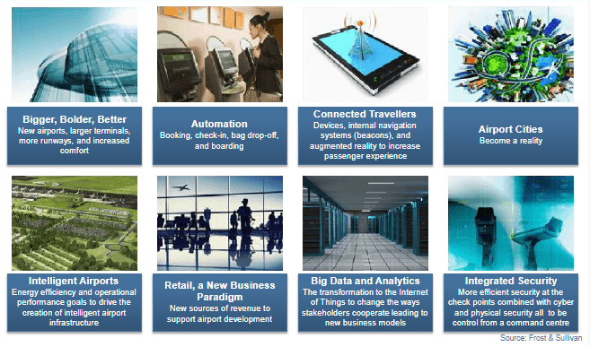
공항조성의 주요 동향
Bigger, Bolder, Better
New airports, larger terminals, more runaways, and increased comfort
Automation
Booking, check-in, bag drop-off, and boarding
Connected Travellers
Devices, internal navigation systems (beacons) and augmented reality to increase passenger experience
Airport Cities
Becomes a reality
Intelligent Airports
Energy efficiency and operational performance goals to drive the creation of intelligent airport infrastructure
Retail, a new business paradigm
New sources of revenue to support airport development
Big data and analytics
The transformation to the internet of things to change the ways stakeholders cooperate leading to new business models
Integrated security
More efficient security at the check points combined with cyber and physical security all to be controlled from a command centre

Slide 17
공항 디지털 전환의 목적과 전략
Vision and Strategy
Technology Strategy
Digital Goals
Vision, Roadmap and Organizational Strategy
Digital Platforms
Customers & Business Models
Big Data
Customers Experience
Digital signage
AR and VR for way finding
Digital Channels
One to many
Many to many
Digital self service
Digital Products and services
Loyalty programs
Apps
New business models
Digital retailing
eCommerce
Employees & Partners
Operational Processes
Cloud
Collaboration
Mobile office
Airport Collaborative
Decision Making (A-CDM)
Culture
Talent acquisition
Training
Innovation
Airport incubators
Internet of things
Baggage Management
Passenger Management
Security Management
Airside Operations
Digital Supply Chain
Logistics and Cargo
Business Operations
Building Management
Enterprise billing
Business intelligence
Resource management
Security
Mobile
Note: A-CDM – Airport Collaborative Decision Making

Slide 18
공항의 주요 변화방향
Creating unique customer experience
Airports are looking at creating delightful in-airport experience for passengers to make a lasting positive impression and brand image. They are also developing customer-focused retail outlet designs to offer a unique shopping experience.
Offering personalized new services
Airports are also offering new range of services like Internet parking booking, a mobile app, loyalty program, to acquire passenger data, which is then leveraged to develop personalized e-merchandizing through personal messaging or notifications sent via IoT or i-Beacons infrastructures. This data also offers new opportunities for revenue generation by selling data to third parties or through targeted marketing.
Getting closer to passengers
Airports are launching their own CRM and loyalty programmes. They are looking at providing a seamless and stress free experience for passengers regardless of which technology or device they use.
Leveraging mobile platform
Airports are looking at developing mobile applications for easy information access, this platform could be leveraged for offering personalized offers and information on product/service availability.
Diversifying sales channels
Offering new services like “pick up on return”, home delivery and pre-order websites.

Slide 19
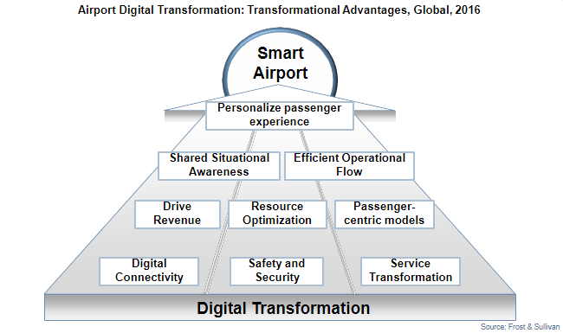
공항의 디지털 전화의 목표 모습

Slide 20
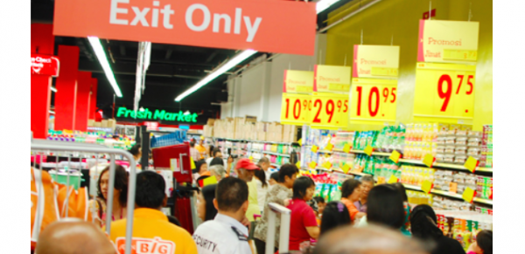






전통적 유통산업의 위기
In USA, over 700 department stores have closed down since 2013.
Retailers | Stores Closed till ’16 | Plans to Close in ’17
 | 36 | 100
 | 278 | 150
 | 269 | -
 | 80 | -
 | - | 70
 | 18 | -
AEON BIG plans to close three stores in Klang Valley
Stores to be closed are Kota Damansara, River City (Jalan Ipoh) and Bangsar South.
Constant declining performance
Significant pressure on margins due to online stores

Slide 21
소비자 여정
Awareness
Research
Purchase
Fulfilment
Loyalty
Learning about brands and products, through TV advertising or online
Finding additional info on product in stores, online through apps
Completing the purchase in a store, online or through mobile
Obtaining the product: collecting in store or having it delivered directly
Engaging with brand by providing feedback or posting reviews
Over 20% of Europeans follow brands on Facebook or Twitter
Across leading markets, 31% of smartphone ownerrs use their phone for shopping-related research
Across major European markets, between 5% and 10% of online spending is made via tablets and a similar amount via mobile
Almost 40% of UK consumers who have bought online in the last year have used click-and-collect
30% of UK and German consumers actively engage with retailers by posting reviews or recommendations online
Same Range Everywhere
Same Availability Everywhere
Same Price Everywhere
Fulfillment Anywhere
Returns Anywhere

Slide 22







O2O 현황 및 조망
Line & WeChat works with retailers to organize flash sales targeting its user base
Coupons & Deals
Online Stores
Blogs, Review sites
SNS, MIM, etc
Search Engines
Online Ads
Decide
Discovery
Price comparison
Group buy/ Spree
Coupons & Deals
Aggregators
Retailers are using Instagram, Pinterest and Facebook to engage and sell to their followers using 3rd party plugins
Alibaba and Tencent have received banking licence to offer internet banking services
Engage
Transac
Omni-Channel Marketing
Rewards & Loyalty
CRM/ Data Analytics
Post-sales Support
Square has extended its offering to include PoS, inventory and cash mgmt and data analytics
Online & Mobile Wallet
Payment Processing
Point-of-Sales

Slide 23
유통업 디지털 전환 사례
Macy’s has been focusing on transforming its business and operating models.
1998
1999
2002
2006-7
2010
2016
Created Macy’s.com
Acquired “Fingerhut” a direct marketer for $1.7 Bn
Sold Fingerhut due to lack of strategic value
Invested $230 mn in Macy’s.com website
Started Digital Transformation and announced holistic Omni Channel strategy
Announced a series of initiatives in its journey to become a preferred omnichannel shopping destination.
Financial Performance
Cuts capital costs: by positioning its store network as online distribution centers.
Trains “front-line” employees: in techniques emphasizing digital integration into the customer service experience.
Brought executive focus: by creating a role of executive VP for omni channel strategy.
Invested $400 million: in renovating its flagship store in Herald Square and tried to bridge the physical and digital divide.
Armed associates with ipads and expediters to quickly find inventory.
Closing 100 full-line stores: to re-create its physical store presence as customer shopping preferences.
Re-allocating Investments: to higher-growth-potential store and digital businesses.
Investing in capacity building: on company’s website, mobile apps and click-and-collect.
Improvement in natural language search, faster page loading and simpler procedures for placing and fulfilling orders.
FY 2014
FY 2015
$ 28,105
Million
$ 1,526
Million
$ 27,079
Million
$ 1,070
Million
Net Sales: -3.7%
Net Income: -29.9%
For 39 weeks ended Oct’16 net sales declined by 5.2% in comparison to 39 weeks ending Oct’15.

